Slide 1
VBScript
Session 15

Slide 2
What we learn last session?

Slide 3
Subjects for session 15
The ActiveX ADODB data model.
Connection Object.
  Creating a DSN ODBC.
  Connecting to a database using connection string
  Connecting to a database using ODBC.
Error Object.
Recordset Object.
  Querying a database.
  Opening recordsets in different configurations.
  Filtering records.
  Searching for records.
  Sorting records.
  Navigating in a recordset.
  Setting bookmarks.
  Adding new records.

Slide 4
ADODB Object Model
Connection
Errors
Error
Command
Parameters
Parameter
Recordset
Fields
Field

Slide 5
ADODB
ADODB Object Model
ADODB is a COM object that enables applications to gain access to, and modify a wide variety of data sources.
A data source may be as simple as a text file, complex as a cluster of heterogeneous databases, or a Relational Database.
The typical data source is a relational database that supports the Open Database Connectivity (ODBC) standard and is manipulated with commands written in Structured Query Language (SQL).

Slide 6
ADODB
Basic ADO Programming Model
ADO provides the means for you to perform the following sequence of actions:
  Connect to a data source. Optionally, you can ensure that all changes to the data source occur either successfully or not at all.
  Specify a command to gain access to the data source, optionally with variable parameters, or optionally optimized for performance.
  Execute the command.
  If the command causes data to be returned in the form of rows in a table, store the rows in a cache that you can easily examine, manipulate, or change.
  If appropriate, update the data source with changes from the cache of rows.
  Provide a general means to detect errors (usually as a result of making a connection or executing a command).

Slide 7
ADODB
Basic ADO Programming Model
The goal of ADO is to gain access to, edit, and update data sources

Slide 8
ADODB
ADO Programming Model in Detail
The following elements are key parts of the ADO programming model:
Objects
  Connection - Enables exchange of data.
  Command - Embodies an SQL statement.
  Parameter - Embodies a parameter of an SQL statement
  Recordset - Enables navigation and manipulation of data.
  Field - Embodies a column of a Recordset object.
  Error - Embodies an error on a connection.
  Property - Embodies a characteristic of an ADO object.
  In this session we will learn only about the connection and recordset object.

Slide 9
ADODB
ADO Programming Model in Detail
The following elements are key parts of the ADO programming model:
Collections
  Errors - All the Error objects created in response to a single failure on a connection.
  Parameters - All the Parameter objects associated with a Command object.
  Fields - All the Field objects associated with a Recordset object.
  Properties - All the Property objects associated with a Connection, Command, Recordset or Field object.

Slide 10
ADODB
Connection Object
Access from your application to a data source is through a connection, the environment necessary for exchanging data.
Your application can gain access to a data source directly, or indirectly through an intermediary like the Microsoft® Internet Information Server (IIS).
ADO accesses data and services from OLE DB providers.
The Connection object is used to specify a particular provider and any parameters.

Slide 11
Connection Object
Connecting to a Data Source
Using a defined DSN (Data Source Name)
Creating a new DSN :
  Start → Control Panel → Administration Tools → Data Sources

Slide 12
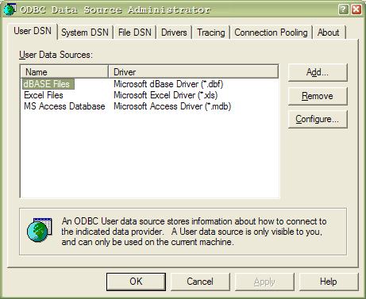
Connection Object
Creating a user DSN
Select user DSN for user DSN or System DSN, for all users
Click Add…

Slide 13
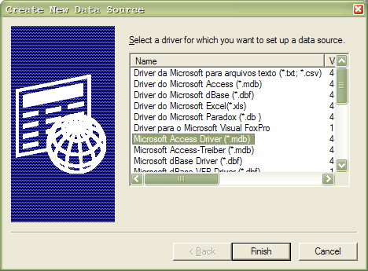
Connection Object
Creating a user DSN
Select Microsoft Access Data driver.
Click finish

Slide 14
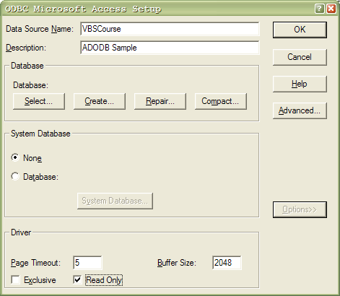
Connection Object
Creating a user DSN
Data source name VBSCourse.
Click select …
Data Source description
ADODB Sample
Read Only.

Slide 15
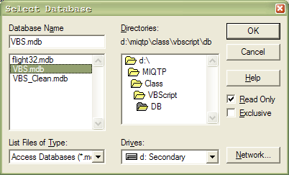
Connection Object
Creating a user DSN
Select file VBS.mdb
Click OK

Slide 16
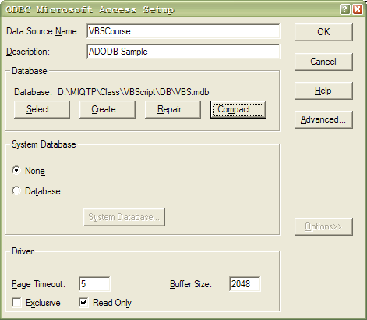
Connection Object
Connecting to a Data Source
Click OK
Remark : for user and password click Advanced …

Slide 17
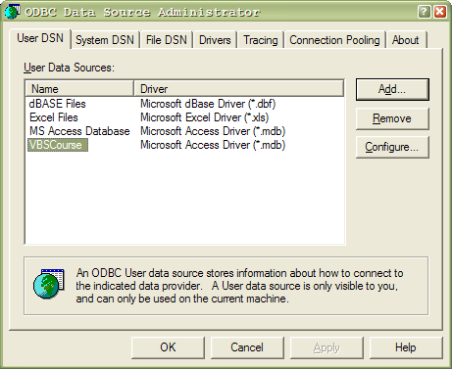
Connection Object
Creating a user DSN
New DSN created.

Slide 18
Connection Object
Connecting to a database
Using the DSN :
  Set objConn = CreateObject (“ADODB.Connection”)
  objConn.Open “VBSCourse”
Using a connection string
  Set objConn = CreateObject (“ADODB.Connection”)
  objConn.ConnectionString = “Provider=Microsoft.Jet.OLEDB.4.0;Data Source=C:\Class\VBScript\DB\VBS.mdb”
  objConn.Open
Or
  objConn.Open strConnectionString

Slide 19
Connection Object
Checking the connection
After we activate the method open to te connection, we must check if the connection was succesfull
  Const adStateOpen = 1
  If Not objConn.State = adStateOpen Then Exit.

Slide 20
ADODB
Connection Object – Errors Collection
Contains all the Error objects created in response to a single failure involving the provider.
Any operation involving ADO objects can generate one or more provider errors.
As each error occurs, one or more Error objects can be placed in the Errors collection of the Connection object.
When another ADO operation generates an error, the Errors collection is cleared, and the new set of Error objects can be placed in the Errors collection.
Each Error object represents a specific provider error, not an ADO error.

Slide 21
ADODB
Error Object
Contains all the Error objects created in response to a single failure involving the provider.
Any operation involving ADO objects can generate one or more provider errors.
As each error occurs, one or more Error objects can be placed in the Errors collection of the Connection object.
When another ADO operation generates an error, the Errors collection is cleared, and the new set of Error objects can be placed in the Errors collection.
Each Error object represents a specific provider error, not an ADO error.
The set of Error objects in the Errors collection describes all errors that occurred in response to a single statement.

Slide 22
ADODB
Error Object
Using the error collection, we can describe to the user the specific error.
  If objConn.State <> adStateOpen Then
  For Each objErr in objConn.Errors
  strMsg = "Error #" & objErr.Number & vbCr
  strMsg = strMsg & “Desc: " & objErr.Description & vbCr
  strMsg = strMsg & “Source: “ & objErr.Source & vbCr
  strMsg = strMsg & “State: " & objErr.SQLState & vbCr
  strMsg = strMsg & “NativeError: " & objErr.NativeError & vbCr
  If objErr.HelpFile = "" Then
  strMsg = strMsg & "No Help file available" & vbCr
  Else
  strMsg = strMsg & “HelpFile: " & objErr.HelpFile & vbCr
  strMsg = strMsg & “HelpContext: " & objErr.HelpContext
  End If
  Next
  End If

Slide 23
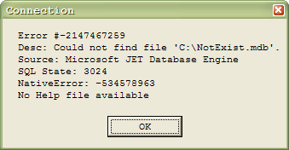
ADODB
Error Object
For Example, we try to connect to C:\NotExist.mdb
This is the error message:

Slide 24
ADODB
Recordset Object
A Recordset object represents the entire set of records from a base table or the results of an executed command.
At any time, the Recordset object refers to only a single record within the set as the current record.
You use Recordset objects to manipulate data from a provider.
When you use ADO, you manipulate data almost entirely using Recordset objects.
All Recordset objects are constructed using records (rows) and fields (columns).
Depending on the functionality supported by the provider, some Recordset methods or properties may not be available.

Slide 25
ADODB
Queying a Database
For querying a database we will use the Open method of the recordset object.
Syntax: recordset.Open Source, ActiveConnection, CursorType, LockType, Options
Source
  Indicates the source for the data in a Recordset object (Command object, SQL statement, table name, or stored procedure).
ActiveConnection
  Indicates to which Connection object the specified Command or Recordset object currently belongs.

Slide 26
ADODB
Queying a Database
CursorType
  Indicates the type of cursor used in a Recordset object.
  Options are:
    adOpenForwardOnly – default, you can only scroll forward through records.
    adOpenKeyset - you can't see records that other users add, although records that other users delete are inaccessible from your recordset.
    adOpenDynamic - Additions, changes, and deletions by other users are visible, and all types of movement through the recordset are allowed.
    adOpenStatic - A static copy of a set of records that you can use to find data or generate reports. Additions, changes, or deletions by other users are not visible.

Slide 27
ADODB
Queying a Database
LockType
  Indicates the type of locks placed on records during editing.
  Options are:
    adLockReadOnly – Default. Read-only—you cannot alter the data.
    adLockOptimistic - Optimistic locking, record by record—the provider uses optimistic locking, locking records only when you call the Update method.

Slide 28
ADODB
Queying a Database
Options
  indicates how the provider should evaluate the Source argument.
  Options are:
    adCmdText - textual definition of a command (SQL)
    adCmdTable - Indicates that ADO should generate an SQL query to return all rows from the table named in Source.
    adCmdTableDirect - Indicates that the provider should return all rows from the table named in Source.
    adCmdStoredProc - Indicates that the provider should evaluate Source as a stored procedure.

Slide 29
ADODB
Querying a database – Example 1
strSQL = “Select * From Employes Where State=‘NY’”
Set objRst = CreateObject(“ADODB.Recordset”)
objRst.Open strSQL, objConn
While Not objRst.EOF
iCounter = iCounter + 1
strRep = “First Name : “ & objRst(“EmpFirstName”).Value & vbCr
strRep = strRep & “Last Name : “ & objRst(“EmpLastName”).Value & vbCr
strRep = strRep & “Address: “ & objRst(“EmpAddress”).Value & vbCr
MsgBox strRep,0,”Employee “ & iCounter
objRst.MoveNext
Loop

Slide 30
ADODB
Querying a database – Example 2
strSQL = “Select * From Employes Where State=‘NY’”
Set objRst = objConn.Execute(strSQL)
While Not objRst.EOF
iCounter = iCounter + 1
strRep = “First Name : “ & objRst(“EmpFirstName”).Value & vbCr
strRep = strRep & “Last Name : “ & objRst(“EmpLastName”).Value & vbCr
strRep = strRep & “Address: “ & objRst(“EmpAddress”).Value & vbCr
MsgBox strRep,0,”Employee “ & iCounter
objRst.MoveNext
Loop

Slide 31
ADODB
Opening recordsets in different configurations.
For best performance, we are able to open recordset in different configurations.
Usually, in testing, we connecting to databases for search or retrieve data.
In testing, when we reading data, we want to be sure that we are not locking the application.

Slide 32
Opening recordsets in different configurations.
The properties LockType and CursorType can assure those requirements.
If we only want to browse a set of records, we set the CursorType to adOpenForwardOnly.
The recommended locktype for testing, is using the flag adLockReadOnly.
Those parameters are the defaults of the properties.

Slide 33
Opening recordsets in different configurations - Example
strCmd = “Employes”
Set objRst = CreateObject(“ADODB.Recordset”)
objRst.Source = strCmd
Set objRst.ActiveConnection = objConn
objRst.CursorType = adOpenForwardOnly
objRst. LockType = adLockReadOnly
objRst.Open ,,,, adCmdTableDirect
‘ objRst.Open strCmd,objConn, adOpenForwardOnly, adLockReadOnly, ‘adCmdTableDirect
While Not objRst.EOF
iCounter = iCounter + 1
strRep = “First Name : “ & objRst(“EmpFirstName”).Value & vbCr
strRep = strRep & “Last Name : “ & objRst(“EmpLastName”).Value & vbCr
strRep = strRep & “Address: “ & objRst(“EmpAddress”).Value & vbCr
MsgBox strRep,0,”Employee “ & iCounter
objRst.MoveNext
Loop

Slide 34
Recordset Object
Filtering records.
In some cases we want to search several sets of data in a recordset.
We can avoid to open many recordsets several times with other SQL’s
Is most efficient, when we have foreign keys.

Slide 35
Recordset Object
Filter Property
Specifies a filter for data in a Recordset.
Sets or returns a Variant value, which can contain :
  Criteria string
  Array of bookmarks
  FilterGroupEnum values.
Use the Filter property to selectively screen out records in a Recordset object.
The filtered Recordset becomes the current cursor.
This affects other properties, such as AbsolutePosition, AbsolutePage, RecordCount, and PageCount, that return values based on the current cursor, because setting the Filter property to a specific value will move the current record to the first record that satisfies the new value.

Slide 36
Recordset Object
Filtering records - Example
For example we want to read all the records where the emplyee lives in New York Or in Washington
For this sample, we have already open the record and selected all the employees.
Now we can execute the follow:
  objRst.Filter = “City = ‘New York’ Or City = ‘Washington’”
The new recordset will contain the filtered records.
A run-time error occurs only if there are conflicts on all the requested records. Use the Status property to locate records with conflicts.
Setting the Filter property to a zero-length string ("") has the same effect as using the adFilterNone constant.

Slide 37
Recordset Object
Searching - Find Method
Searches a Recordset for the record that satisfies the specified criteria.
If the criteria is met, the recordset position is set on the found record; otherwise, the position is set on the end of the recordset.
Syntax
  recordset.Find (criteria, SkipRows, searchDirection, start)

Slide 38
Recordset Object
Searching - Find Method
criteria
  A String containing a statement that specifies the column name, comparison operator, and value to use in the search.
SkipRows
  An optional Long value, whose default value is zero, that specifies the offset from the current row or start bookmark to begin the search.
searchDirection
  An optional SearchDirectionEnum value that specifies whether the search should begin on the current row or the next available row in the direction of the search.
  Its value can be adSearchForward or adSearchBackward. The search stops at the start or end of the recordset, depending on the value of searchDirection.
start
  An optional Variant bookmark to use as the starting position for the search.

Slide 39
Recordset Object
Searching - Find Method - Example
Suppose we want to find all the in an already open recordset, all the records where the State of the employee starts with the letter M (i.e Massachusetts)
objRst.Find(“State Like M*”,0, adSearchForward)

Slide 40
Recordset Object
Sorting Records - Sort Property
Specifies one or more field names on which the Recordset is sorted, and whether each field is sorted in ascending or descending order.
Settings and Return Values - Sets or returns a String of comma-separated field names to sort on, where each name is a Field in the Recordset, and is optionally followed by a blank and the keyword ASC or DESC, which specifies the field sort order.
The data is not physically rearranged, but is simply accessed in the sorted order.

Slide 41
Recordset Object
Navigating in a recordset
We can navigate in a recordset in any desired direction using the MoveFirst, MoveLast, MoveNext, and MovePrevious Methods.
Moves to the first, last, next, or previous record in a specified Recordset object and makes that record the current record.
You can’t navigate to previous or first if you open the recordset adOpenForwardOnly flag.
Example : objRst.MoveFirst, objRst.MoveNext

Slide 42
Recordset Object
Navigating in a recordset
  BOF
  Jhon Erwin New York NY
  James Walter Olathe KS
  Jenny Elliot Los-Angeles CA
  Will Smith Houston TX
  Jacob Graham Chicago IL
  Sara Roberts Atlanta GR
  EOF

Slide 43
Recordset Object
Setting Bookmarks - Bookmark Property
Returns a bookmark that uniquely identifies the current record in a Recordset object or sets the current record in a Recordset object to the record identified by a valid bookmark.
Settings and Return Values - Sets or returns a Variant expression that evaluates to a valid bookmark.
Use the Bookmark property to save the position of the current record and return to that record at any time. Bookmarks are available only in Recordset objects that support bookmark functionality.

Slide 44
Recordset Object
Setting Bookmarks - Example
Dim varBookmark
objRst.MoveLast
objRst.MovePrevious
varBookmark = objRst.Bookmark
objRst.MoveFirst
objRst.MoveNext
objRst.Bookmark = varBookmark

Slide 45
Recordset Object
Navigating in a recordset – Move Method
Moves the position of the current record in a Recordset object.
Syntax
  recordset.Move NumRecords, Start
    NumRecords - A signed Long expression specifying the number of records the current record position moves.
    Start - Optional. A String or Variant that evaluates to a bookmark.
      adBookmarkCurrent - Default. Start at the current record.
      adBookmarkFirst - Start at the first record.
      adBookmarkLast - Start at the last record.

Slide 46
ADODB
Adding a New Record – AddNew Method
Dim iEmpID
Dim bSupport
If objRst.Supports(adAddNew) Then
  objRst.AddNew objRst(“EmpID”) = iEmpID
  objRst(“fname”) = strFirstName
  objRst(“lname”) = strLastName
  objRst.Update
  If Err.Number <> 0 Then
  MsgBox “Error adding new record”
  End If
End If

Slide 47
ADODB
Adding a New Record – Example
Usually, in testing, we don’t add new records to the database.
The AddNew method Creates a new record for an updatable Recordset object.
Syntax
  recordset.AddNew FieldList, Values
Use the AddNew method to create and initialize a new record.
Use the Supports method with adAddNew to verify whether you can add records to the current Recordset object.
After you call the AddNew method, the new record becomes the current record and remains current after you call the Update method.

Slide 48
ADODB
Tips – Using SQL
Use SQL instead of iterative operations.
You can execute queries directly using Execute
Example
Dim rs
Set rs = CreateObject(“ADODB.Recordset”)
Rs.Open “Select * From Users Where…”,conn,3,3
Set rs = conn.Execute(“Select * From Users Where…”)

Slide 49
ADODB
Tips - Counting
Example
rs.Open “Select * From Users”,conn,3,3
rs.MoveFirst
Do Until rs.EOF
If rs(“State”) = “FL” Then i = i + 1
rs.MoveNext
Loop
strSQL = “Select Count(State) As emp_count From Users Where state=‘FL’”
Set rs = conn.Execute(strSQL)

Slide 50
ADODB
Tips - Searching
Example
rs.Open “Select * From Users”,conn,3,3
rs.MoveFirst
Do Until rs.EOF
If rs(“State”) = “FL” Then bFound = True
rs.MoveNext
Loop
strSQL = “Select * From Users Where state=‘FL’”
Set rs = conn.Execute(strSQL)
if Not rs.EOF then bFound = True

Slide 51
ADODB
Tips - Summing
Example
rs.Open “Select * From Users”,conn,3,3
rs.MoveFirst
Do Until rs.EOF
iTotal = iTotal + rs(“Salary”)
rs.MoveNext
Loop
strSQL = “Select Sum(Salary) As total_sal From Users’”
Set rs = conn.Execute(strSQL)
MsgBox rs(“total_sal”)

Slide 52
ADODB
Tips - Updating
Example
Do Until rs.EOF
rs(“Salary”) = rs(“Salary”) * 1.05
rs.Update
rs.MoveNext
Loop
strSQL = “UPDATE Users SET salary=salary*1.05’”
Set rs = conn.Execute(strSQL)

Slide 53
ADODB
Tips - Deleting
Example
Do Until rs.EOF
if rs(“Country”) = ‘UK’ Then rs.Delete
rs.MoveNext
Loop
strSQL = “DELETE FROM Users WHERE Country=‘UK’’”
Set rs = conn.Execute(strSQL)

Slide 54
Lab 15.1
Write an interactive program to navigate in a recordset.
Build a new DNS connection.
An input box should ask the user
  1 – Go to the first record.
  2 – Go to the next record.
  3 – Set a bookmark.
  4 – Go to the bookmark.
  5 – Go to the previous record.
  6 – Go to the last record.
  7 – Add a new record.
Be aware of EOF and BOF
Use the table Employees in the Database.
Error handling.

Slide 55
Make sure to visit us
Tutorials
Articles
Proikects
And much more
www.AdvancedQTP.com

